Slide 1





Microsoft Azure Community
Day 2025
10 May | Saturday | Sofia

Slide 2











Proudly Hosted by
Our Generous Sponsors

Slide 3
Stanislav Zhelyazkov
Microsoft MVP
12 years
Cloudadministrator.net
Cloud Infrastructure Engineer
Accenture: Netherlands
https://www.linkedin.com/in/stanislavzhelyazkov

Slide 4
Master IaC with Azure Bicep
My tips and tricks
Why Azure Bicep?
Q&A

Slide 5
Why Azure Bicep?
Flexibility
Security & Control
Community
Latest Azure features
Prevents drift
Monthly calls
Move at your own pace
Prevents deletion
Influence features
Beyond Azure
Full idempotency
Report bugs

Slide 6
How to Pass Resources Between Modules
Notes:
Example 1

Slide 7
Use Custom Failures
Notes:
Example 2

Slide 8
How to Test Lambda Functions
Notes:
Example 3

Slide 9
Define Default Values for Parameters
Notes:
Example 4

Slide 10
Resource Location
resource sqlServer 'Microsoft.Sql/servers@2024-05-01-preview' = {
name: 'sqlServerName'
location: resourceGroup().location
properties: {
...
}
}

Slide 11
Deployment Scopes
Use
Subscription Scope
Management Group Scope
Do not use
Tenant Scope, use scope: tenant() for resources like Microsoft.Subscription/aliases
Resource Group Scope

Slide 12
Use Deployment Stacks
New-AzSubscriptionDeploymentStack `
-Name "<deployment-stack-name>" `
-Location "<location>" `
-TemplateFile "<bicep-file-name>" `
-ActionOnUnmanage “deleteAll" `
-DenySettingsMode “denyWriteAndDelete"
az stack sub create \
--name '<deployment-stack-name>' \
--location '<location>' \
--template-file '<bicep-file-name>' \
--action-on-unmanage ‘deleteAll' \
--deny-settings-mode ‘denyWriteAndDelete'
Action on Unmanaged – Delete All
Deny Settings Mode – Deny Write and Delete
Exclude Actions related to operations
Exclude via Entra Groups and use PIM for Groups

Slide 13
Overcome for (loops) limitations with map() function
Notes:
Example 5

Slide 14
Spread Operator is Your Friend
Notes:
Example 6

Slide 15
User-Defined Data Types
Schemas
Document your input
Allows grouping multiple properties and configured as one
Improve end user experience
Prevent deployment failures
Improve how you write code
Place UDDT in separate files and use import
Notes:
Example 7

Slide 16
How to Discover Properties For Features

Slide 17
Q&A
Examples at https://github.com/slavizh/azure-bootcamp-2025

Slide 18


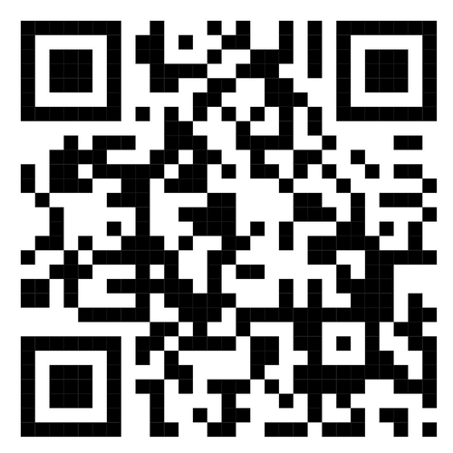
Thank You
Next to Beer.js Summit 2025
01
02
Wed | 23 July 2025
Scan ME

